Slide 1
Beyond the Spectrum

Slide 2
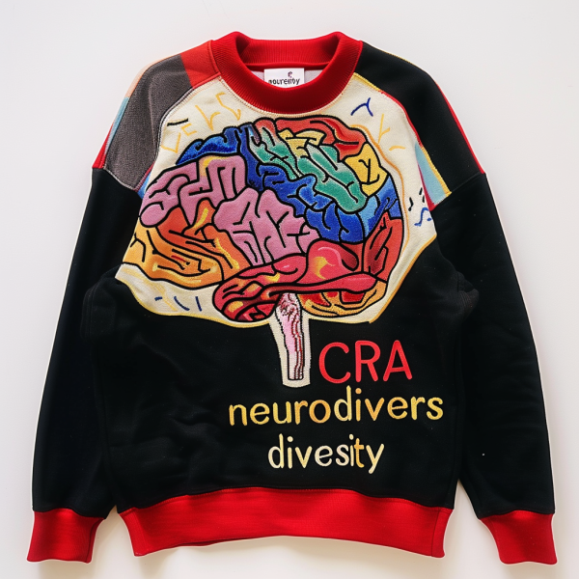
Understanding Neurodiversity
Neurodiversity refers to the natural variation in human brain function and behavior, emphasizing that neurological differences such as autism, ADHD, and dyslexia are part of human diversity rather than deficits.
Notes:
Recognizing neurodiversity fosters inclusivity and understanding, allowing minority neurodivergent youth to thrive by promoting acceptance and reducing stigma associated with their conditions.
Supporting neurodivergent youth is crucial for their personal growth and societal contribution, as it enhances their self-esteem, social skills, and overall well-being through tailored therapeutic interventions.

Slide 3
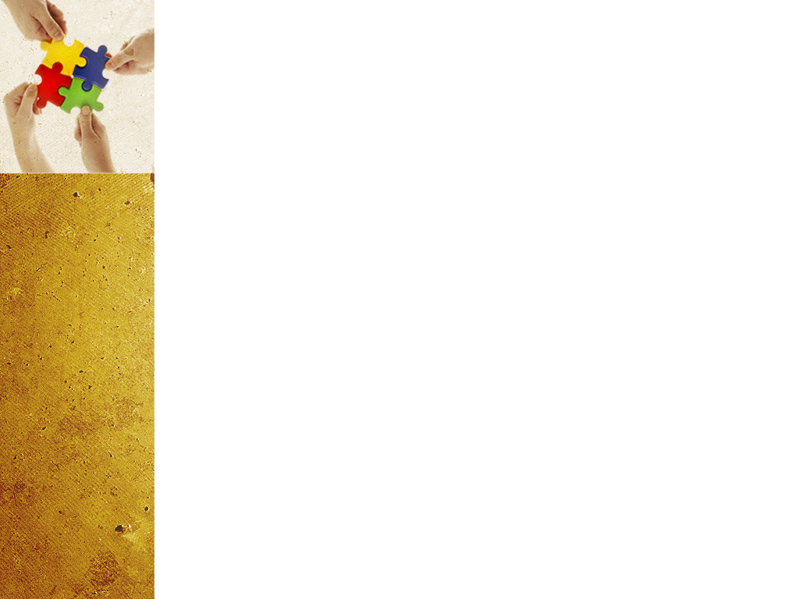
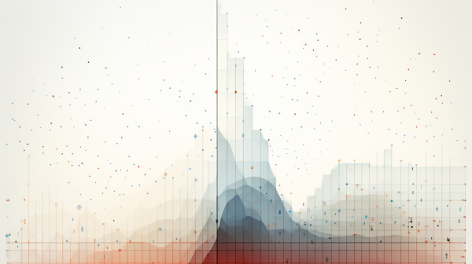
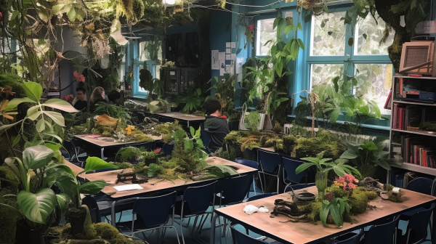
Challenges Faced by Minority Neurodivergent Youth
Access to Resources
Educational Inequities
Notes:
Minority children often face significant barriers in accessing therapeutic services due to systemic inequities, including geographic isolation and a shortage of culturally competent providers in their communities. This leads me to the supporting data I found regarding this.
Many families struggle with financial limitations that prevent them from affording necessary therapeutic services, particularly when insurance coverage is inadequate or non-existent for mental health care.
These youth frequently face inadequate educational resources and support systems that fail to accommodate their unique learning needs, resulting in lower academic achievement and increased feelings of isolation, further complicating their social interactions and mental health.

Slide 4
How Beyond the Spectrum Helps
Access to Resources
- Our organization bridges the gap between underserved families and essential therapeutic resources, facilitating access to care that is often delayed or unavailable due to systemic barriers.
Community Engagement Initiatives
- We actively engage with local communities to raise awareness about mental health, promote inclusivity, and empower families to advocate for their children's therapeutic needs.

Slide 5
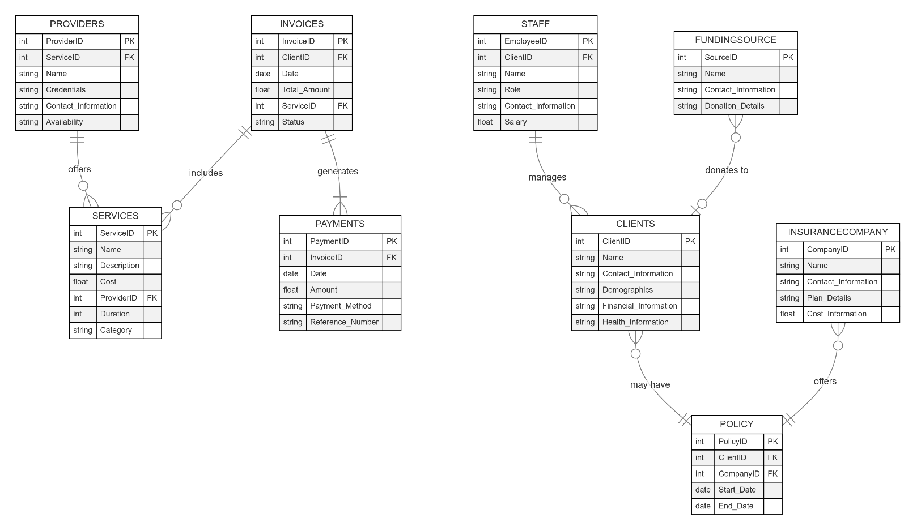
Our Business Model

Slide 6
Thank you!

